Slide 1
Project:- Investigate a Relational Database
By: Yashika Paneri

Slide 2
1): Which genre of movie were most checked out in the 4th quartile of rental duration?
<In the 4th quartile of longest rented out movies, ‘Animation’ and ‘Family’ movies were the most popular genre.

Slide 3
2): What is the shortest and longest rental duration?
<Shortest rental duration is three days while the longest is seven days. Also seen from the graph, same rental days can be categorized into either 1st or 2nd quartile. >

Slide 4
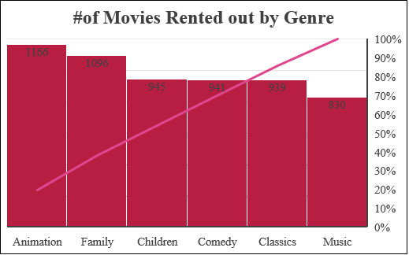
3): How many times were ‘Animation Movies’ rented out?
<Animation movies was rented out the most followed by family genre. Music genre was the least rented out category among family movies. >

Slide 5
4): How many rentals did each store process in July and August of 2005?
<Both stores performed similar in terms of rentals in both July and August of 2005>
*I couldn’t produce the whole data because the Project page was down (It contained ‘papers’ ERD not ‘actors’)
→ This data is from what I jotted down earlier while I was doing the project

